Slide 1
A Data Mining Framework to Analyze Road Accident Data
Submitted to: Presented by-
Rahul Pradhan Sir Anujay Jain
Hemlata Saraswat
Rajeev Kumar Yadav
Shahaban Ali

Slide 2
Contents
ABSTRACT
INTRODUCTION
PROBLEM DEFINITION
EXISTING SYSTEM
LITERATURE SURVEY
HARDWARE & SOFTWARE REQUIREMENTS
DESIGN AND IMPLEMENTATION
COMPILED RESULTS WITH COMPARISON
CONCLUSION
REFERENCE

Slide 3
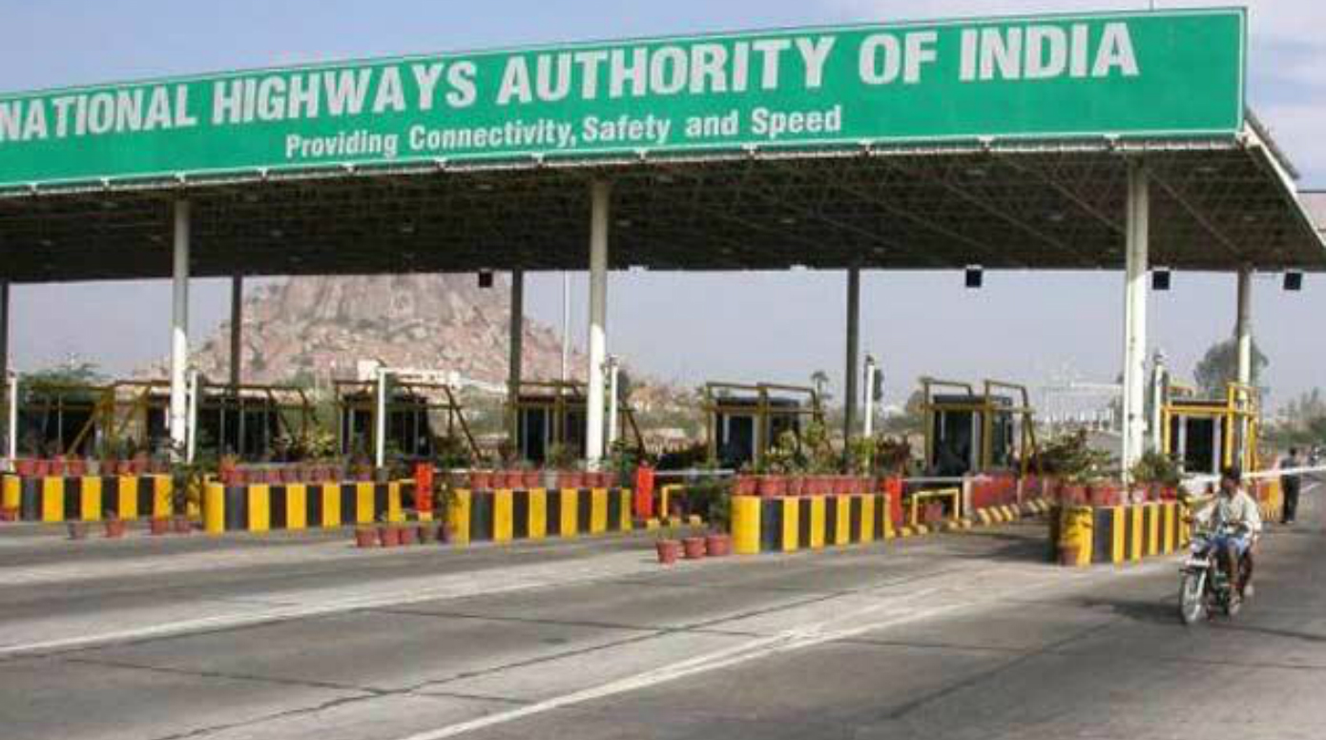
Abstract
In the developed as well as developing countries, Infrastructure development is one of the major investment by the government, while safety of passengers on roads is of utmost importance.
A road optimization during the construction or during maintenance phase, requires that the engineers analyze all the parameters that play a crucial role in ensuring safety for the passenger sand preventing accidents.
One of the key objectives in accident data analysis is to identify the main factors associated with road accidents.

Slide 4
Tools Required
HARDWARE REQUIREMENTS
Processor Type: Intel Core I5-6200u Cpu
Processor Speed: 2.30 Ghz
Hard Disk: 1 Tb
Ram: 8 Gb
SOFTWARE REQUIREMENTS
Operating System: Ubuntu
Front End: Apache Zeppelin
Back End: Scala-Spark

Slide 5
Introduction
ROAD ACCIDENT DATA

Slide 6
Problem Definition
Analyze Road Accident Data

Slide 7
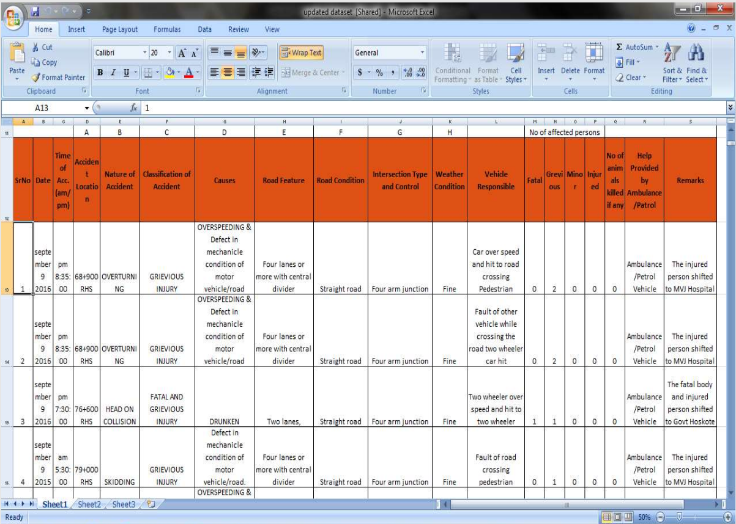

Slide 8
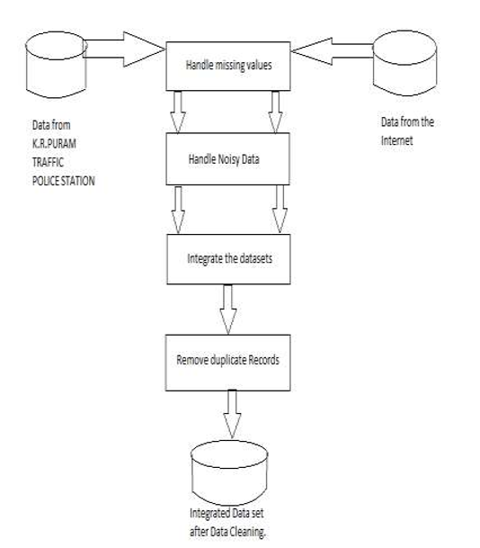
Data Preprocessing
.

Slide 9
Key Objective Recognition
Segmentation
Models
Result
Notes:
Accident data for this research were obtained from GVK-Emergency Management Research Institute, Dehradun. The data set consists of 11,574 road accidents for 6 years period from 2009 to 2014, in Dehradun District of Uttarakhand State. After preprocessing of the data, 11 variables were identified satisfactory for the research. The data set comprised of accident characteristics (time, day, month, type of accident, number of injured victims), victims age and gender, road type, road feature and area around accident site.

Slide 10
DATA WE HAVE :

Slide 11
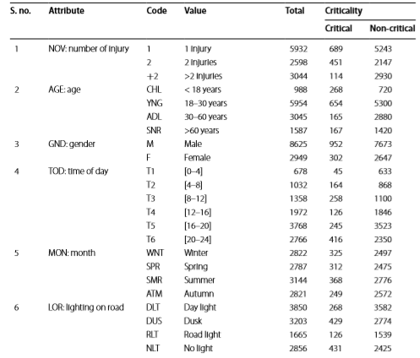

Slide 12
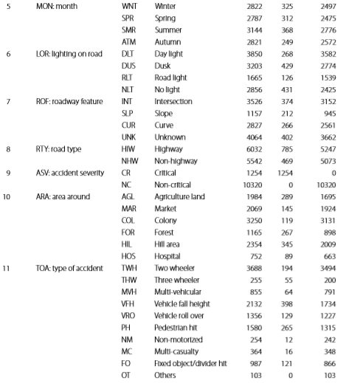

Slide 13
MODELS
Clustering
Association Rule Mining

Slide 14
CLUSTERING
Two wheeler accidents and non-highway roads
Two wheeler accidents through a hill area, forest area or agriculture land area
Accidents which were due to vehicle falling down from height
Accidents involving multiple vehicle accidents and divider hit/fixed object hit cases
Notes:
Association rule for cluster 1 shows that two wheeler accidents are mainly occurs on specific road segments such as intersections at community areas, i.e., colony, markets and hospitals. Intersections in colonies near highways are more prone to two wheeler accidents than colonies on non-highways.
It consists of two wheeler accidents that occurred on highway that goes through a hill area, forest area or agriculture land area. In this cluster 64 % of accidents involved more than two injuries and 26 % accidents involved 1 injury and rest involved more than 2 injuries.
It consists of all accidents which were due to vehicle falling down from height. Around 80 % of these cases are critical where ARA was hill. Rest of the accidents of this category
It has been observed that 40 % of these accidents have happened on the forest and agriculture land areas. About 55 % of vehicle roll over cases are found at unknown road features.
Association rules for cluster 6 indicate that vehicle roll-over accidents are occurred at night in forest area and roads near agriculture land areas. A slope in forest road and a curve on road is the reasons involved in these accidents

Slide 15
Accidents involving pedestrian hit cases
Accidents involving vehicle roll-over case
Notes:
Contrary to supervised learning where we have the ground truth to evaluate the model’s performance, clustering analysis doesn’t have a solid evaluation metric that we can use to evaluate the outcome of different clustering algorithms. Moreover, since kmeans requires k as an input and doesn’t learn it from data, there is no right answer in terms of the number of clusters that we should have in any problem. Sometimes domain knowledge and intuition may help but usually that is not the case. In the cluster-predict methodology, we can evaluate how well the models are performing based on different K clusters since clusters are used in the downstream modeling.

Slide 16
ASSOCIATION RULE MINING

Slide 17
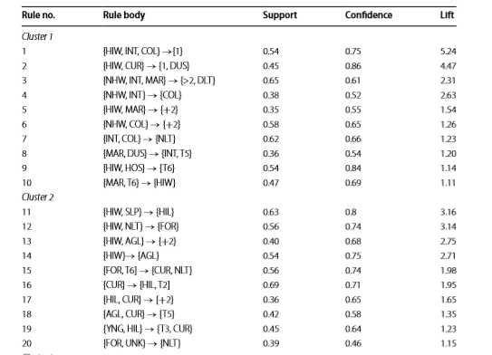
RESULT

Slide 18
Conclusion

Slide 19
Refrences

Slide 20


